Slide 1

GROUP EXPENSE TRACKER
Guide:
Mrs. Rajashri Kulkarni
BY-
Neha Walture
Snehal Kadam
Renuka Deshmukh
Lopamudra Chakraborty

Slide 2
PRESENTATION AGENDA
1.
2.
Objectives
3.
Market Scenario
4.
Features
5.
Technologies Used
Problem Statement
6.
Functional Modules
7.
Hardware and Software Requirements
8.
Pre-Requisites
9.
Conclusion

Slide 3
PROBLEM STATEMENT
Track expenses on Android phone
Create groups
Should work, even if Internet is not available on disposable
1.
2.
3.

Slide 4
OBJECTIVE
1.
Manages financial accounts
2.
View expenses
3.
Send notifications

Slide 5
MARKET SCENARIO
PaisaGate
iPhone web application
2-way interactive service using SMS
Expense Sharer 1.16
Book-keeping program
Email the balance to the participants
Mobile Cashbook
Android application
Tracking incomes, daily expenses and monthly balance sheet

Slide 6
FEATURES
1.
Maintaining expenses
2.
Provides integration with Facebook
3.
Creating groups
4.
Adding new member manually
5.
Sending notifications
6.
“Who owes how much and to whom?”
7.
Clearing dues
8.
Archiving file if all dues paid

Slide 7
TECHNOLOGIES USED
ANDROID
Software Stack:- OS, Middleware, Key applications
Provides tools and APIs (Java)
SQLite
Open Source Library
Implements transactional SQL database engine
RUBY ON RAILS
Object-oriented programming language
Open Source Web framework

Slide 8
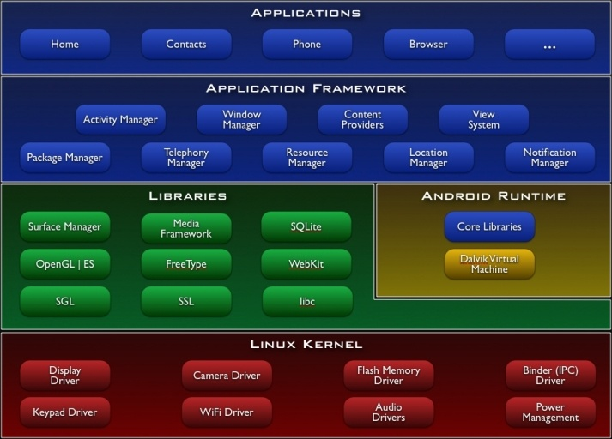
ANDROID ARCHITECTURE

Slide 9
WHY ANDROID?
Totally open API
Device and network-independent software platform
True multi-tasking OS based on Linux kernel
Android OS is updated often!

Slide 10
WHY SQLite?
Embedded RDBMS
Public domain
Faster
Implements transactional, self-contained, serverless, zero configurational DB engine
Cross platform
Simple API
Version 3.7.4

Slide 11
WHY RUBY ON RAILS?
Don’t Repeat Yourself
Knowledge must have single, unambiguous representation of the system
Modification of single element does not change logically unrelated elements
Conventional over Configuration
Decreases no. of decisions
Gaining simplicity, but losing flexibility
OO language
Mix-in modules: provide independent code to inject into classes
Simplifying client code behavior
ActiveRecord
No need to specify database column names in class definitions
Object Relationship mapping tool

Slide 12
FUNCTIONAL MODULES
Generate Reports
Login
Group Creation
Logging Expenses
Send Notifications

Slide 13
OVERVIEW OF DATA REQUIREMENTS
PERSONAL DETAILS
Name
Username
GROUP DETAILS
Group name
Group currency
EXPENSE DETAILS
Transactions ID
Payee
Password
Contact number
Email address
Time stamp
Amount
Members list involved in expenses

Slide 14
OPERATING ENVIRONMENT
SOFTWARE REQUIREMENTS
HARDWARE REQUIREMENTS
Android SDK
SQLite for database server
RubyOnRails
Eclipse 3.4 platform
GIT
ANT
Middle-ware: REST
A mobile handset with Android platform
2 GB RAM
120 GB HDD
For computer:

Slide 15
PRE-REQUISITES
Android compatibility
Internet services required
One member log-in
1.
2.
3.

Slide 16
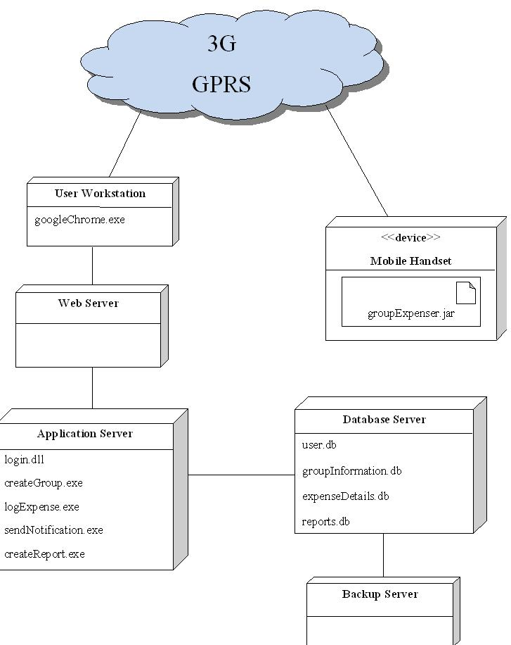
DEPLOYMENT DIAGRAM

Slide 17
FUTURE ENHANCEMENTS
2.
Individual currency for each group member
3.
Providing Credit System for sending SMS
1.
Finding friends through GPRS

Slide 18
CONCLUSION
Overview of Android mobile application synchronized with a web-application to track the expenses on the go.

Slide 19
REFERENCES
1.
www.souptonuts.sourceforge.net
www.rubyonrails.com
www.android.com
www.googlehandsetalliance.com
www.sqlitebrowser.sourceforge.net
5.
www.dev.mysql.com
www.mysql.com
www.guides.rubyonrails.org
www.tutorized.com
10.
www.startvbdotnet.com
www.aspnet.com
www.en.wiki.org
www.allenbrowne.com
2.
3.
4.
6.
7.
8.
9.
11.
12.
13.

Slide 20
THANK YOU!!!

